Slide 1
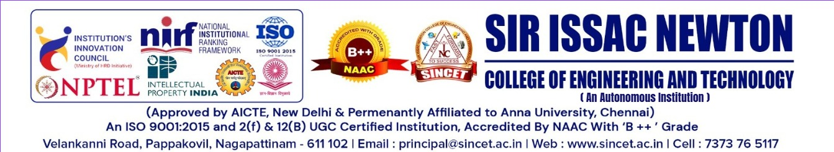
PRIVACY –PRESERVING DECENTRALIZED ACCESS CONTROL SYSTEM USING BLOCKCHAIN, IPFS AND ZERO-KNOWLEDGE PROOFS
Department of Computer Science & Engineering
Project Guidance
Project by
Team Members
Mrs.B. Brinda Bonsalin B.Tech.,M.E.,
Aakash .T (821722104001)
Assistant Professor
Jayasuriya .R (821722104016)
Department of CSE
Joswa .K (821722104019)
Manoj .G (821722104701)

Slide 2
ABSTRACT
In the era of digital transformation, centralized cloud storage systems pose significant security and privacy risks, including data breaches, unauthorized access, and dependency on third-party providers.
Traditional centralized models store sensitive information in a single repository, making it vulnerable to attacks and creating a trust imbalance for users.
The proposed system introduces a decentralized framework using Blockchain, InterPlanetary File System (IPFS), and advanced cryptographic methods to ensure secure, privacy-preserving, and scalable data storage and sharing.
Cryptographic techniques like Elliptic Curve Cryptography (ECC), proxy re-encryption, and zero-knowledge proofs allow users to retain full control over their data while enabling secure access for authorized parties without exposing sensitive information.

Slide 3
INTRODUCTION
Cloud storage has become essential for data management and online services, but centralized systems create vulnerabilities such as data breaches, unauthorized access, and reliance on third-party providers.
Traditional centralized models store sensitive user information in single repositories, making them attractive targets for cyberattacks and reducing user trust.
There is a growing need for a secure, transparent, and privacy-preserving framework that allows users to maintain control over their data while sharing and accessing it efficiently.
The proposed system leverages decentralized technologies like Blockchain and IPFS, along with cryptographic methods such as Elliptic Curve Cryptography (ECC), proxy re-encryption, and zero-knowledge proofs, to enhance data security and privacy.

Slide 4
LITERATURE SURVEY
TITLE | AUTHOR & YEAR | TECHNIQUE/ALGORITHM | MERIT | DEMERIT
A blockchain-assisted electronic medical records by using proxy reencryption and multisignature | Liu, Xiaoguang, Jun Yan, Shuqiang Shan, and Rongjun Wu (2022) | Blockchain, Proxy Re-encryption, Multisignature | Ensures secure sharing of medical records and prevents unauthorized access | Implementation complexity; high computational cost
A novel cloud enabled access control model for preserving the security and privacy of medical big data | Alabdulatif, Abdullah, Navod Neranjan Thilakarathne, and Kassim Kalinaki (2023) | Cloud-based Access Control | Preserves privacy of medical big data; scalable model | Depends on cloud service reliability; centralization risk
Privacy-preserving data in IoT-based cloud systems: A comprehensive survey with AI integration | Dhinakaran, D., et al. (2024) | AI-based Privacy-preserving Techniques | Provides comprehensive framework for IoT data security; integrates AI for intelligent control | Survey-based; lacks practical implementation results
Smart contract token-based privacy-preserving access control system for industrial Internet of Things | Wang, Weizheng, et al. (2023) | Blockchain, Smart Contracts, Token-based Access Control | Automated access control; secure and transparent for IoT applications | Requires blockchain infrastructure; may have latency issues
An efficient privacy-preserving control mechanism based on blockchain for E-health applications | Alsuqaih, Hanan Naser, et al. (2023) | Blockchain-based Privacy-preserving Mechanism | Enhances data privacy and security in E-health; tamper-proof | High computation and storage requirements; complex deployment

Slide 5
EXISTING SYSTEM
Centralized cloud storage systems rely on a single authority, usually the service provider, to manage user authentication, data access, and storage.
All user credentials, encryption keys, and access permissions are stored in centralized databases, making them vulnerable to cyberattacks and data breaches.
Users must trust third-party providers to handle their personal and sensitive data, often without full transparency about how the data is used or shared.
Centralized management creates a single point of failure, where server outages or attacks can disrupt access to all stored data.
Existing systems lack scalability, flexibility, and sufficient privacy preservation, as data ownership and access policies are controlled by service providers rather than the users themselves.

Slide 6
DISADVANTAGES
Users have limited control over their personal data and access permissions.
Centralized storage creates a single point of failure, increasing the risk of data breaches.
The system depends heavily on third-party providers, reducing transparency and trust.
Unauthorized access or misuse of sensitive information is more likely.
Server outages or attacks can disrupt access to all stored data.

Slide 7
PROPOSED SYSTEM
Introduces a decentralized and cryptographically secure framework for cloud data storage and sharing, eliminating reliance on centralized authorities.
Utilizes Blockchain, InterPlanetary File System (IPFS), and Elliptic Curve Cryptography (ECC) to ensure data confidentiality, integrity, and transparency.
Data owners encrypt files using ECC before uploading, while IPFS provides distributed, tamper-resistant storage and blockchain records metadata and access logs.
Integrates proxy re-encryption and zero-knowledge proofs to enable secure file sharing and access verification without exposing sensitive credentials.
Empowers users with full control over their data, ensuring verifiable, traceable, and privacy-preserving access while minimizing cyberattack risks.

Slide 8
ADVANTAGES
Ensures strong data security using Elliptic Curve Cryptography (ECC) with efficient encryption.
Eliminates the risk of centralized data breaches through decentralized storage using IPFS.
Provides transparent and tamper-proof access control via blockchain integration.
Enhances user privacy through proxy re-encryption and zero-knowledge proof mechanisms.
Gives users complete control over data sharing and access permissions.

Slide 9

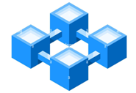


SYSTEM ARCHITECTURE
Data owner
Send request
Data user
Request keys
Upload sensitive data
Get access permission
Data encrypted (ECC + AES)
Blockchain
Share key
Decrypt file using Key
Zero knowledge proof (AKP)
Store encrypted data
Access data
Issue private key and public key
Issue proxy re-encryption key
File encrypted using proxy key
Re-encrypted the encrypted key

Slide 10
ARCHITECTURE EXPLANATION
The system architecture is decentralized, integrating Blockchain for secure transaction logging, IPFS for distributed file storage, and ECC for encryption of user data.
Data owners encrypt their files using ECC before uploading, ensuring confidentiality, while IPFS stores the files in a distributed, tamper-resistant manner.
Blockchain records metadata such as file hashes, access permissions, and transaction logs, providing transparency, immutability, and verifiable access control.
Proxy re-encryption allows secure sharing of encrypted files with authorized users without revealing the original encryption keys, maintaining privacy.
Zero-knowledge proofs enable verification of user authorization without disclosing sensitive credentials, ensuring trustless, privacy-preserving, and scalable access to cloud data.

Slide 11
LIST OF MODULES
DATA OWNER MODULE
CLOUD SERVER MODULE
IPFS MODULE
DATA USER MODULE

Slide 12
MODULES DESCRIPTION
Data Owner Module
Responsible for uploading and managing files in the system.
Encrypts files using Elliptic Curve Cryptography (ECC) before storage.
Sets access permissions for authorized users.
Can track file access and monitor who has permissions.
Initiates proxy re-encryption for secure file sharing.
Maintains control and ownership of all data uploaded to the system.

Slide 13
MODULES DESCRIPTION
Cloud Server Module
Acts as the interface between data owners, users, and IPFS storage.
Receives encrypted files from data owners for storage in IPFS.
Manages metadata, including file hashes and access logs.
Ensures availability and retrieval of files for authorized users.
Communicates with blockchain to verify transactions and permissions.
Provides scalable cloud storage without compromising security.

Slide 14
MODULES DESCRIPTION
IPFS Module
Stores encrypted files in a decentralized and distributed manner.
Ensures tamper-resistant and immutable file storage.
Provides file addressing through unique content hashes.
Reduces dependency on a single central server, avoiding single points of failure.
Facilitates efficient file retrieval and sharing across the network.
Integrates with the cloud server and blockchain to maintain secure file storage.

Slide 15
MODULES DESCRIPTION
Data User Module
Allows users to request and access files shared by data owners.
Verifies authorization via blockchain and zero-knowledge proofs.
Uses proxy re-encryption to decrypt shared files securely.
Ensures that only legitimate users can access encrypted content.
Can track their access history and permissions for accountability.
Provides a secure and privacy-preserving interface for file consumption.

Slide 16
CONCLUSION
The proposed decentralized cloud storage system effectively addresses the security and privacy challenges of traditional centralized models.
Integration of Blockchain, IPFS, and Elliptic Curve Cryptography (ECC) ensures secure, tamper-proof, and distributed storage of sensitive data.
Proxy re-encryption and zero-knowledge proofs provide enhanced privacy and controlled access, allowing users to securely share files without exposing credentials.
Users gain full ownership and authority over their data, reducing dependency on third-party providers and increasing trust.
The system demonstrates a scalable, transparent, and resilient framework that strengthens data confidentiality, integrity, and overall cloud security.

Slide 17
FUTURE ENHANCEMENTS
Integration of advanced AI-based anomaly detection to identify and prevent unauthorized access in real-time.
Expansion of multi-cloud support to enable cross-platform decentralized storage and improve scalability.
Implementation of smart contracts on blockchain for automated access control and payment mechanisms.
Enhancement of user interface and experience for seamless file management and sharing.
Adoption of post-quantum cryptographic techniques to future-proof the system against quantum attacks.

Slide 18
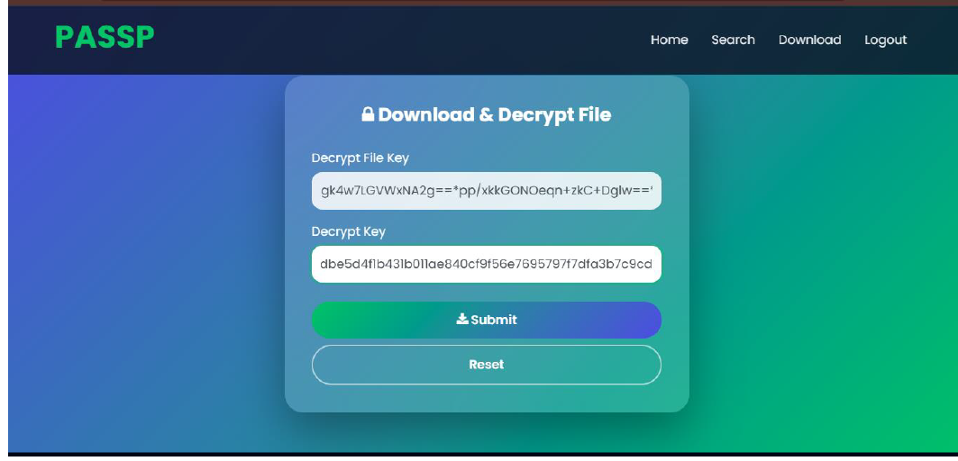
OUTPUT SCREENSHOT

Slide 19
REFERENCE
[1] Liu, Xiaoguang, Jun Yan, Shuqiang Shan, and Rongjun Wu. "A blockchain-assisted electronic medical records by using proxy reencryption and multisignature." Security and Communication Networks 2022 (2022).
[2] Alabdulatif, Abdullah, Navod Neranjan Thilakarathne, and Kassim Kalinaki. "A novel cloud enabled access control model for preserving the security and privacy of medical big data." Electronics 12.12 (2023): 2646.
[3] Dhinakaran, D., et al. "Privacy-preserving data in IoT-based cloud systems: A comprehensive survey with AI integration." arXiv preprint arXiv:2401.00794 (2024).
[4] Wang, Weizheng, et al. "Smart contract token-based privacy-preserving access control system for industrial Internet of Things." Digital Communications and Networks 9.2 (2023): 337-346.
[5] Alsuqaih, Hanan Naser, et al. "An efficient privacy-preserving control mechanism based on blockchain for E-health applications." Alexandria Engineering Journal 73 (2023): 159-172.

Slide 20
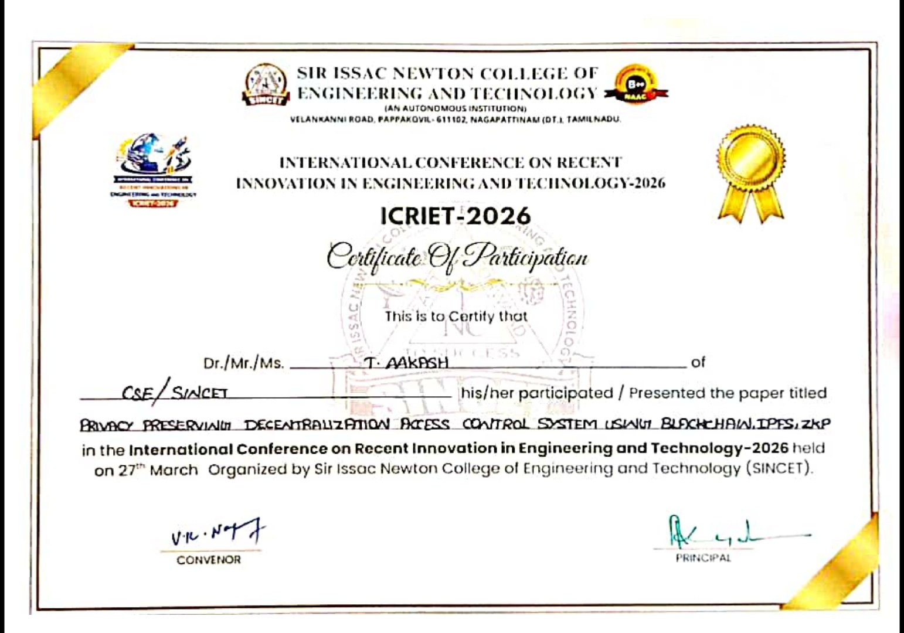

Slide 21
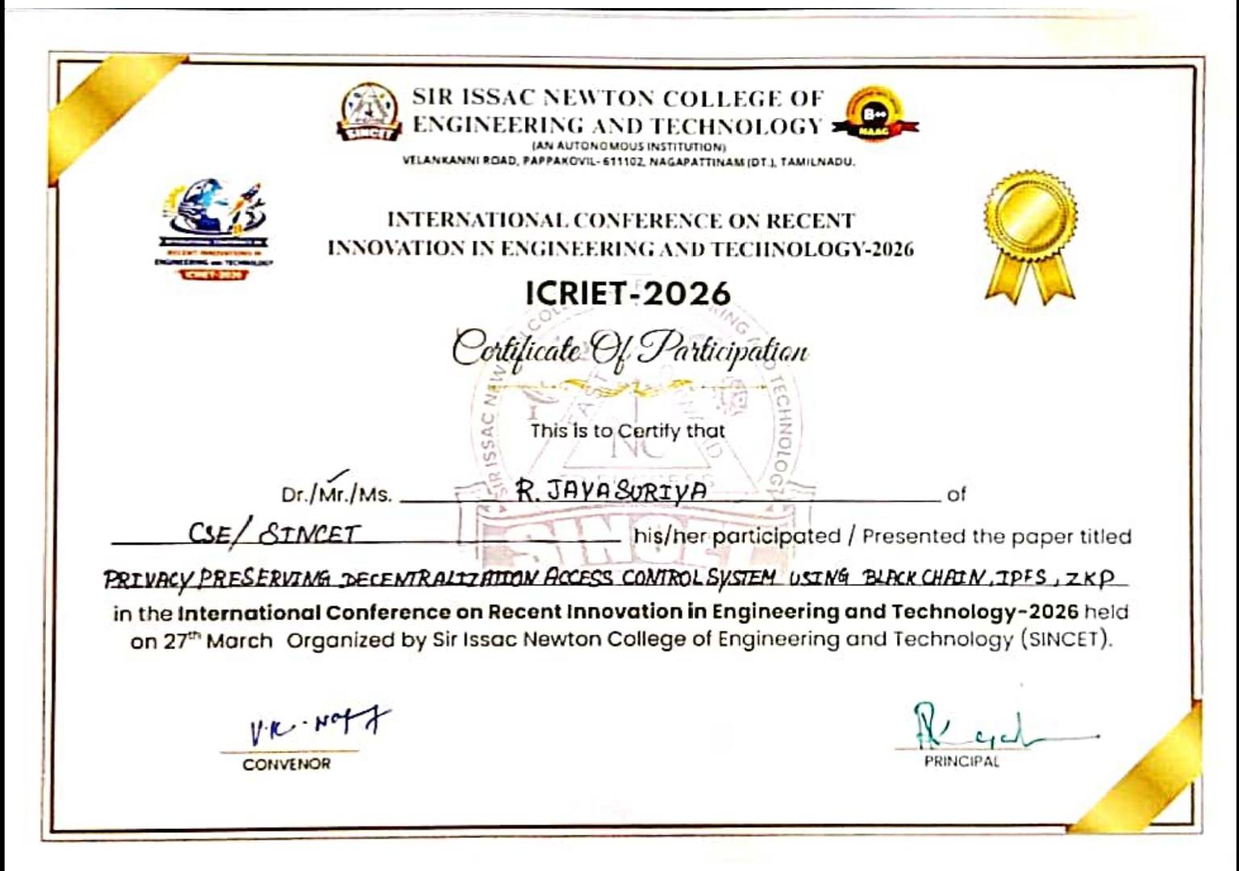

Slide 22
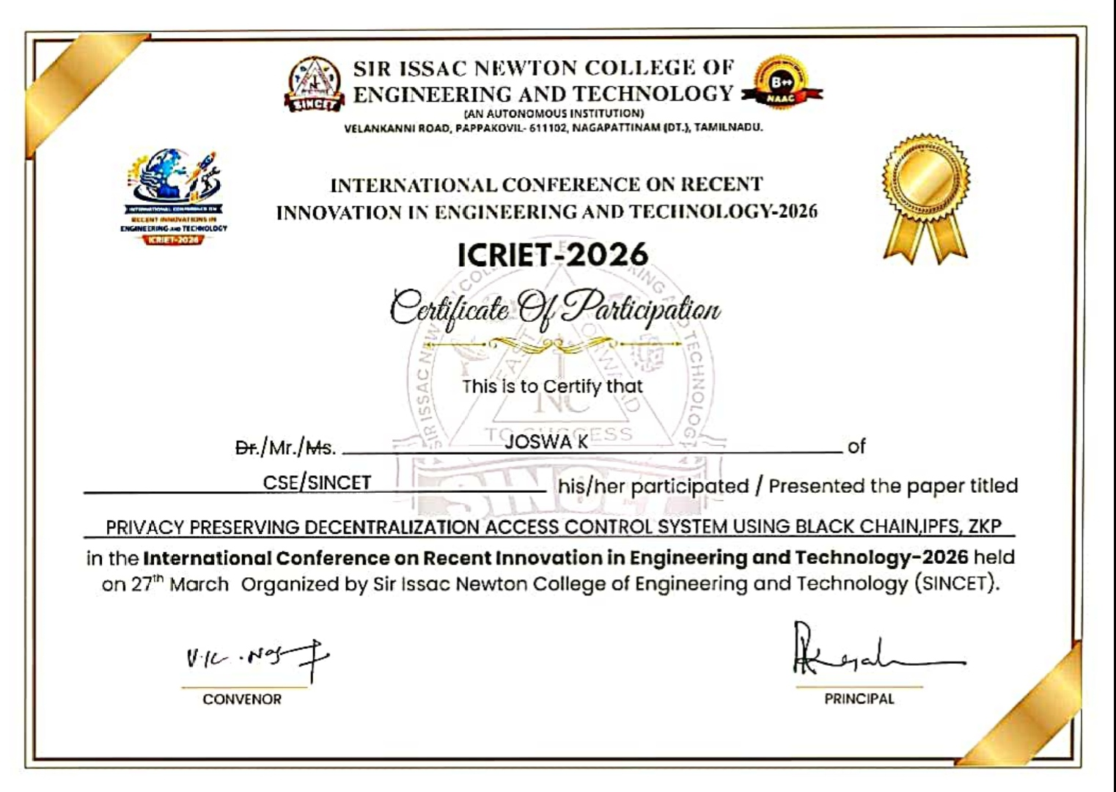

Slide 23
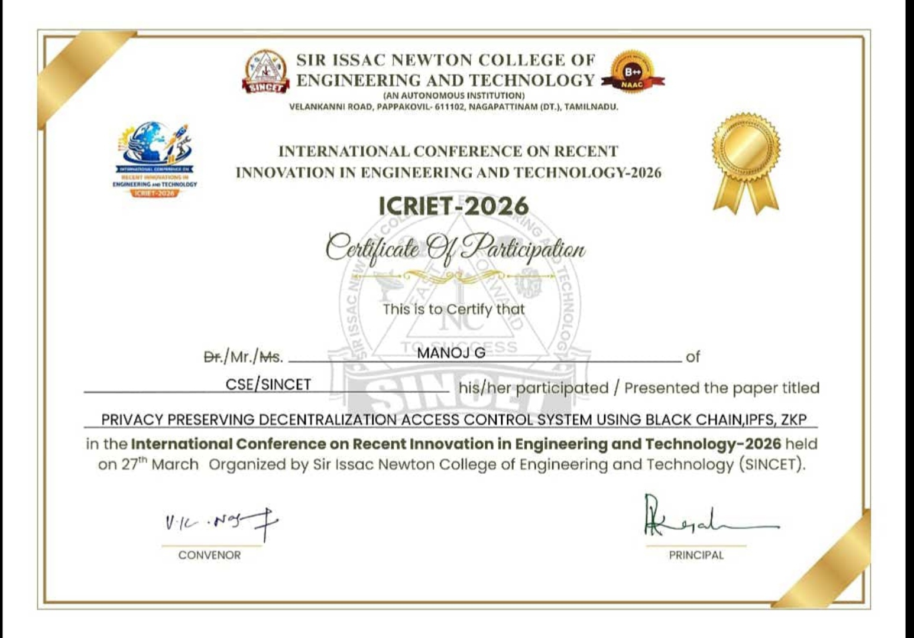

Slide 24
THANKYOU

